Slide 1

EXPLORATORY DATA ANALYSIS
Of
Big Basket.
Data Analysis By:
Akrit Sood.

Slide 2

INTRODUCTION
BigBasket is the largest online grocery supermarket in India. Launched around 2011, it has steadily expanded its business across the country, becoming a household name for online grocery shopping. Despite the entry of new competitors such as Blinkit and others, BigBasket has maintained its strong market position, thanks to its ever-growing customer base and the rising trend of online purchasing among Indian consumers.
E-commerce (electronic commerce) refers to the buying and selling of products or services through online platforms or over the Internet. It leverages a range of technologies, including mobile commerce, electronic funds transfer, supply chain management, internet marketing, online transaction processing, electronic data interchange (EDI), inventory management systems, and automated data collection. The e-commerce sector is powered by technological advances in the semiconductor industry and has become the largest segment within the global electronics industry.

Slide 3
Objectives
Perform exploratory data analysis (EDA) on BigBasket’s product dataset.
Analyze key attributes like:
Product name, category, subcategory, brand.
Sale price vs. market price.
Product type and customer ratings.
Identify:
Top- and least-selling products.
Discount patterns across products.
Missing values and outliers in the data.
Generate meaningful visualizations and plots to uncover trends.
Provide insights to support better business decisions, optimize product offerings, and improve customer satisfaction.

Slide 4
STEPS TO FOLLOW
Step 1: Load DataSet.
Step 2: Use head function to look for the first 12 rows.
Step 3: Get Description of the data in the DataFrame.
Step 4: Find Information about the DataFrame.
Step 5: Find out Top & least sold products.
Step 6: Measuring discount on a certain item.
Step 7: Find out the Missing Values from the Dataset.
Step 8: Find out the outliers from the dataset according to the columns and fill them with the mean.
Step 9: Create Plots or visualizations.

Slide 5
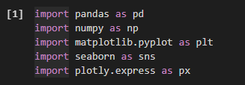


STEP 1: LOAD DATASET
Here I am using Google Colab Notebook for work.
The dataset has been imported from my laptop.
As we begin our Exploratory Data Analysis (EDA). I’ve named the dataset “df1”. After that, I made a copy of the dataset in “df”.
This dataset has 27555 rows and 10 columns.
For cleaning the Dataset, I used Python libraries like Numpy, Pandas, Matplotlib, Plotly, and Seaborn.
(Import libraries)
(Import the Dataset and store it in the df1 variable. After that, make a copy and store it in the df variable.)
(Shape of Dataset)

Slide 6
DESCRIPTION OF THE DATA IN THE DATASET
Index: A distinct identifier assigned to each record in the dataset.
Product: The name or title of the product as it appears on the platform.
Category: The general classification under which the product falls.
Sub-Category: A more detailed classification within the general category.
Brand: The brand linked to the product.
Sale_Price: The price at which the product is sold to customers on the platform.
Market_Price: The typical price of the product in the market.
Type: The classification or nature of the product.
Rating: The feedback or rating given by consumers for the product.
Description: An in-depth explanation offering context about the dataset.

Slide 7
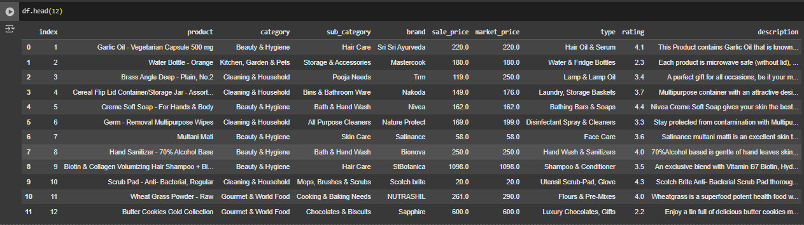
STEP 2: USE HEAD FUNCTION TO LOOK FOR THE FIRST 12 ROWS

Slide 8
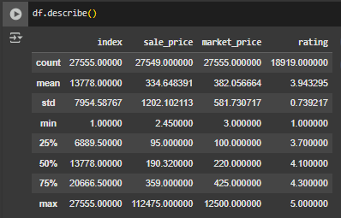
STEP 3: GET DESCRIPTION OF THE DATA IN THE DATAFRAME
The BigBasket dataset contains a total of 27,555 records.
The average sale price is ₹334.65, ranging from as low as ₹2.45 to as high as ₹112,475, while the average market price is ₹382.06, with values spanning from ₹3 to ₹12,500.
Product ratings have an average of 3.94 out of 5, with minimum and maximum ratings of 1 and 5, respectively.
The data shows high price variability, indicating a diverse product mix that includes both low-cost and premium items.
Ratings suggest generally positive customer feedback, with a median rating around 4.1 and 75% of products rated above 4.3.
It is also noted that ratings are available for approximately 18,900 products, meaning some records have missing rating information.

Slide 9
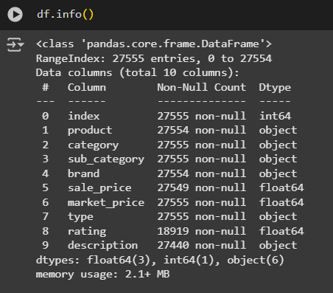
STEP 4: FINDING INFORMATION ABOUT THE DATAFRAME
Dataset Overview – BigBasket
Total records (rows): 27,555
Total columns: 10
Memory usage: ~2.1 MB
Main columns and data types:
Index → int64
Product, Category, Sub-category, Brand, Type, Description → object (string)
Sale_Price, Market_Price, Rating → float64
Complete columns (no missing values):
Index, Category, Sub-category, Type, Market_Price

Slide 10
STEP 4: FINDING INFORMATION ABOUT THE DATAFRAME
Columns with missing data:
Product → 6 missing
Brand → 1 missing
Sale_Price → 6 missing
Rating → ~8,636 missing (only 18,919 present)
Description → 85 missing
Key observations:
The dataset is generally clean but has notable gaps in ratings.
Minor missing values in product, price, and description.
There are major missing values in the Rating column.

Slide 11
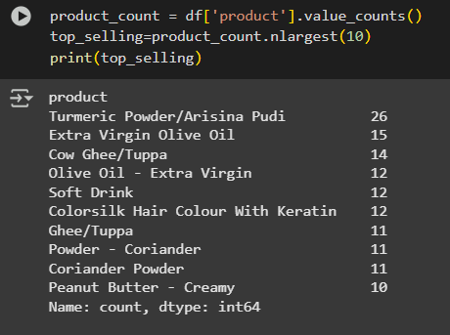
STEP 5: FIND OUT TOP & LEAST 10 SELLING PRODUCTS
Top-Selling Products (BigBasket)
Turmeric Powder / Arisina Pudi → 26
Extra Virgin Olive Oil → 15
Cow Ghee / Tuppa → 14
Olive Oil – Extra Virgin → 12
Soft Drink → 12
Colorsilk Hair Colour With Keratin → 12
Ghee / Tuppa → 11
Powder – Coriander → 11
Coriander Powder → 11
Peanut Butter – Creamy → 10
Insight: Core grocery staples like spices, oils, and dairy products dominate the top-selling list.

Slide 12
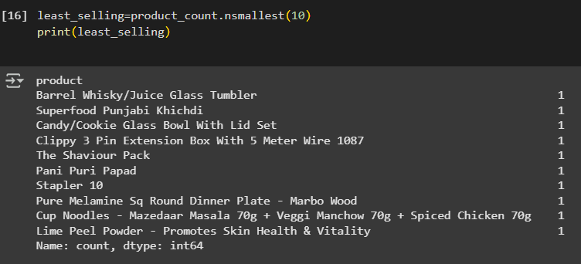
STEP 5: FIND OUT TOP & LEAST 10 SELLING PRODUCTS
Least-Selling Products (BigBasket) (EACH →1)
Barrel Whisky / Juice Glass Tumbler
Superfood Punjabi Khichdi
Candy / Cookie Glass Bowl With Lid Set
Clippy 3 Pin Extension Box (5m Wire)
The Shaviour Pack
Pani Puri Papad
Stapler 10
Pure Melamine Dinner Plate – Marbo Wood
Cup Noodles Combo Pack
Lime Peel Powder (Skin Health & Vitality)
Insight: Least-selling items are niche, specialty, or non-grocery products, indicating low demand or limited listings.

Slide 13
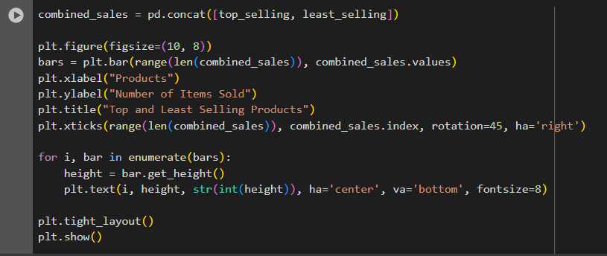
STEP 5: FIND OUT TOP & LEAST 10 SELLING PRODUCTS
VISUALIZATION REPRESENTATION OF THE TOP AND LEAST SOLD ITEMS:

Slide 14
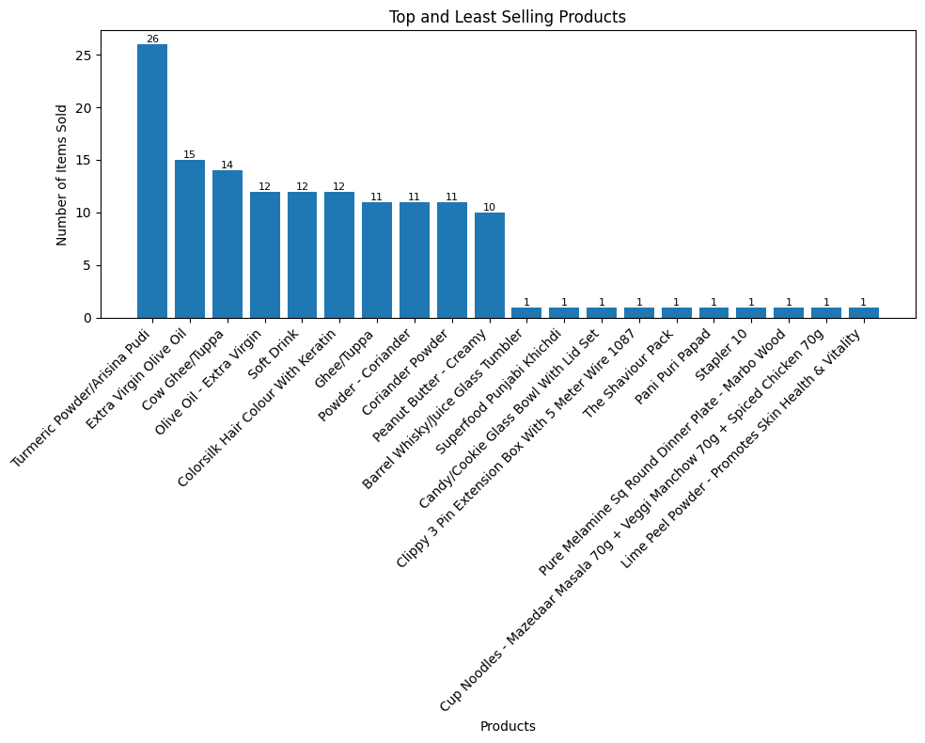
GRAPH

Slide 15
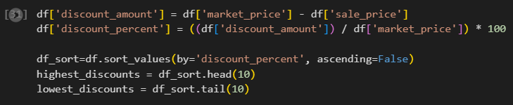
STEP 6: MEASURING DISCOUNT ON A CERTAIN ITEM
Formula:
Discount_amount = Market_Price – Sale_Price
Discount_percent = (Discount_amount / Market_Price)/100
Here, I take the top 10 highest and lowest discount items.

Slide 16
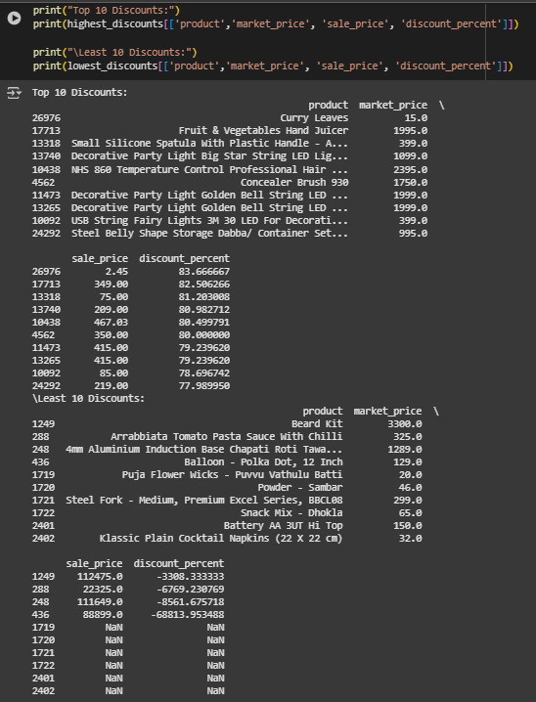
STEP 6: MEASURING DISCOUNT ON A CERTAIN ITEM
Top 10 Discounts (High Percentage)
Curry Leaves (83.7%).
Fruits & Vegetables Hand Juicer (82.5%).
Small Silicone Spatula with Plastic Handle (81.2%).
Decorative Party Light Big Star String (80.98%).
NHS 800 Temperature Control Hair Device (80.5%).
Concealer Brush 938 (80.0%).
Decorative Golden Bell String LED (79.2%).
Decorative Golden Bell String LED (79.2%).
USB String Fairy Lights 3M (78.69%).
Steel Baby Storage Dabba (77.98%).
Key insight: These products offer steep discounts, making them attractive to price-sensitive customers.

Slide 17
STEP 6: MEASURING DISCOUNT ON A CERTAIN ITEM
Observations:
The top discounts (up to ~84%) are applied mostly to low-cost household and kitchen products like curry leaves, spatulas, and juicers — suggesting the business may be trying to boost small-ticket sales or clear excess stock.
Several high-discount items are decorative lights (party lights, star strings, fairy lights), likely reflecting seasonal promotions tied to festivals, holidays, or clearance sales after festive periods.
Products like the NHS hair device and concealer brush show that personal care items are also aggressively discounted, possibly to attract new customers or increase brand awareness in a competitive market.
The decorative golden bell string LED appears twice in the top discount list, which may indicate duplicate product records or the same product listed under slightly different variations — pointing to a need for data standardization.
Most of the highly discounted products are non-essential or luxury-use goods, not daily essentials. This suggests the business is using discounts to move discretionary items rather than staple products.
Large discount percentages (over 75%) can signal price anchoring strategies — where an inflated ‘market price’ is set to make discounts look attractive, even if the actual selling price is closer to the regular market value.
Conclusion:
The analysis shows that BigBasket focuses its highest discounts on small, seasonal, and non-essential products to boost short-term sales. While this helps clear inventory, it risks reducing profit margins. Additionally, duplicate product entries and missing data highlight the need for better data management and more strategic discounting to support long-term business growth.

Slide 18
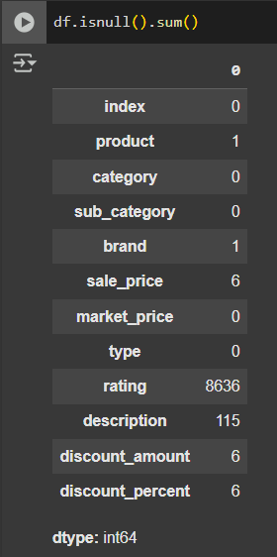
STEP 7: FIND OUT MISSING VALUES FROM THE DATASET
Columns with Missing Values:
Product : 1 Missing Value.
Brand : 1 Missing Value.
Sale_Price : 6 Missing Values.
Rating : 8636 Missing Values.
Description : 115 Missing Values.
Discount_amount : 6 Missing Values.
Discount_percent : 6 Missing Values.
Other columns have No Missing Values.

Slide 19
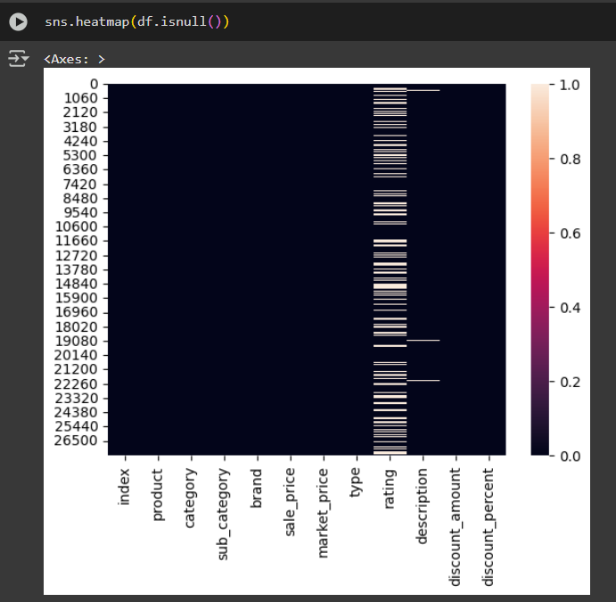
STEP 7: FIND OUT MISSING VALUES FROM THE DATASET
Heatmap:
The heatmap visualizes missing (null) values across all columns of the dataset using the formula:
Sns.heatmap(df.isnull()).
Dark colors indicate no missing values; light stripes indicate missing data.
These missing values must be handled (e.g., filled, removed, or imputed) to ensure clean and accurate analysis.

Slide 20

STEP 7: FIND OUT MISSING VALUES FROM THE DATASET
Data Cleaning and Pre-Processing:
Product and Brand column has 1 missing value each. So, to clean them, I drop that row from both columns.
Sale_Price column has 6 missing values. So, to clean them, I just replace the missing value with the mean of the column to ensure data completeness.
Rating column has 8636 missing values. So, to clean them, I just replace the missing value with the mode of the column to ensure data completeness.
For the Description attribute, which has 115 null values, filling in the missing entries with the Unknown keyword will help ensure data completeness.

Slide 21
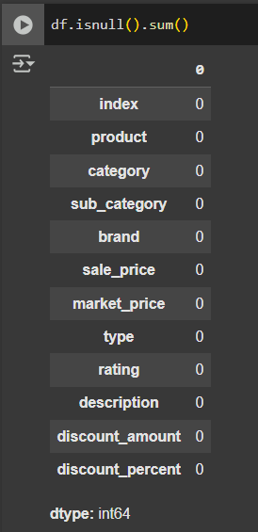
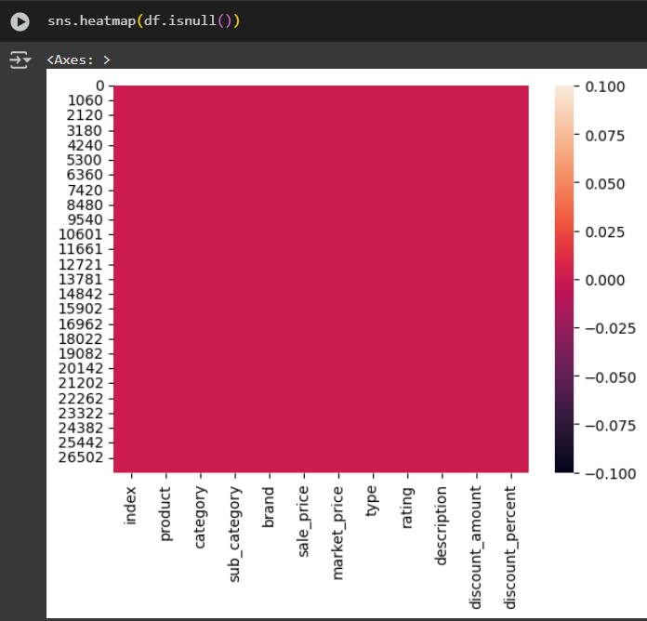
STEP 7: FIND OUT MISSING VALUES FROM THE DATASET
Data Cleaning and Pre-Processing:
5. For both Discount_amount and Discount_percent attributes, both have 6 null values. So, to clean them, I just replace the missing values with the mean of the column to ensure data completeness.
Outcome:
The updated heatmap (sns.heatmap(df.isnull()))
now shows no white lines, meaning all missing
values have been successfully filled.

Slide 22
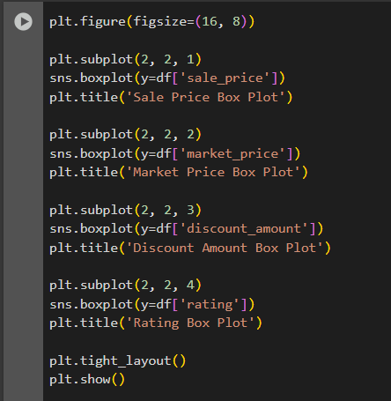
STEP 8: FIND OUT THE OUTLIERS FROM THE DATASET ACCORDING TO THE COLUMNS AND FILL THEM WITH THE MEAN
Finding Outliers in different columns by creating a boxplot.
Columns are: sale_price, market_price, discount_amount, rating.

Slide 23
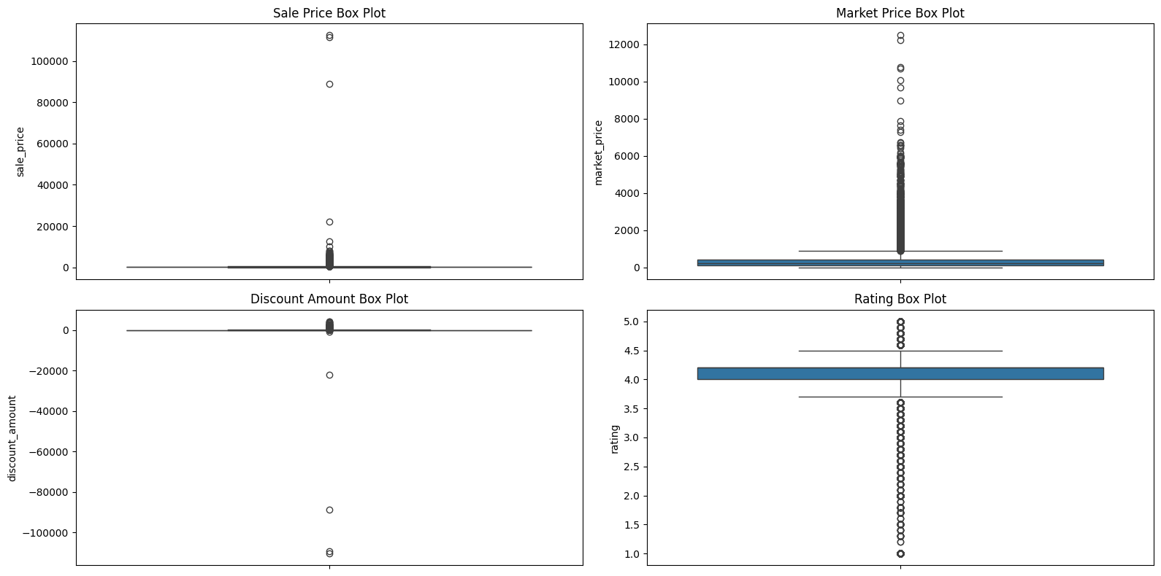
OUTPUT
Key Insights:
Sale Price: There are extreme high-value outliers, with most products priced very low but a few spiking over ₹100,000.
Market Price: Similar to sale price, the majority of products cluster at low market prices, but sharp outliers above ₹12,000 exist.
Discount Amount: There are strange negative discount amounts (which should not happen), suggesting possible data entry or calculation errors.
Rating: Most products have high ratings (around 4), but some very low ratings (below 2) stand out as negative outliers.

Slide 24
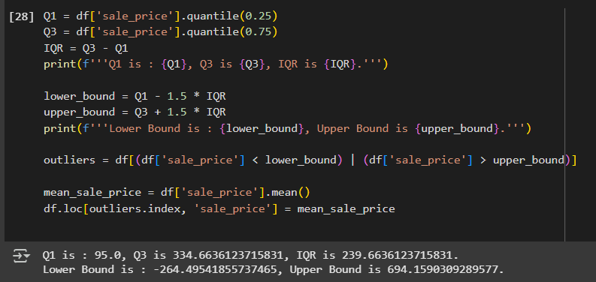
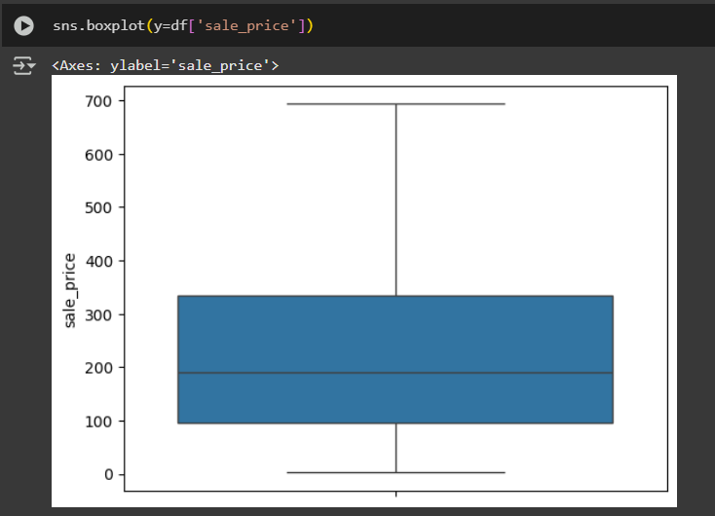
REMOVING OUTLIERS
To address these outlier, we will apply IQR method:

Slide 25
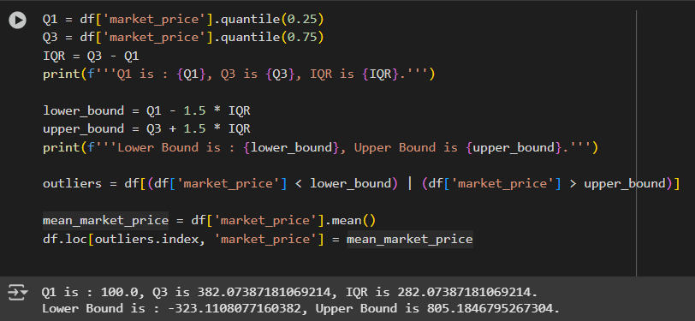
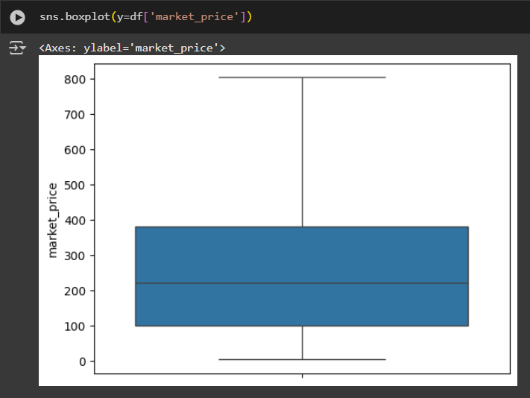
REMOVING OUTLIERS
To address these outlier, we will apply IQR method:

Slide 26
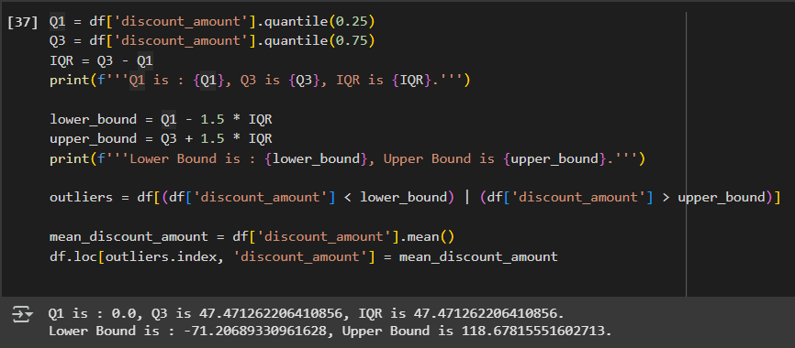
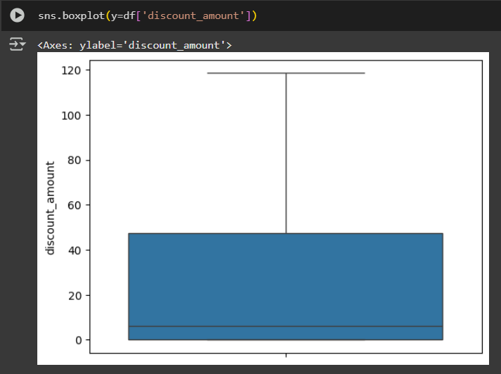
REMOVING OUTLIERS
To address these outlier, we will apply IQR method:

Slide 27
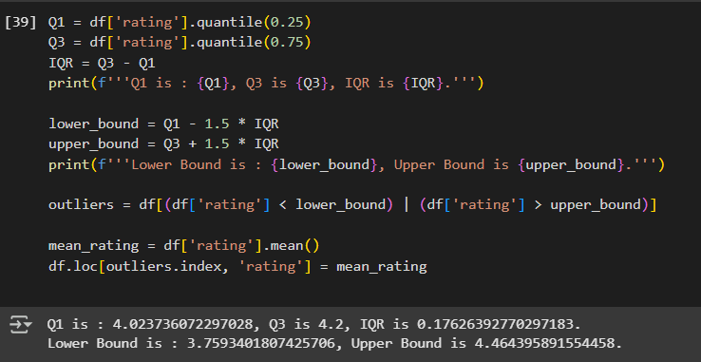
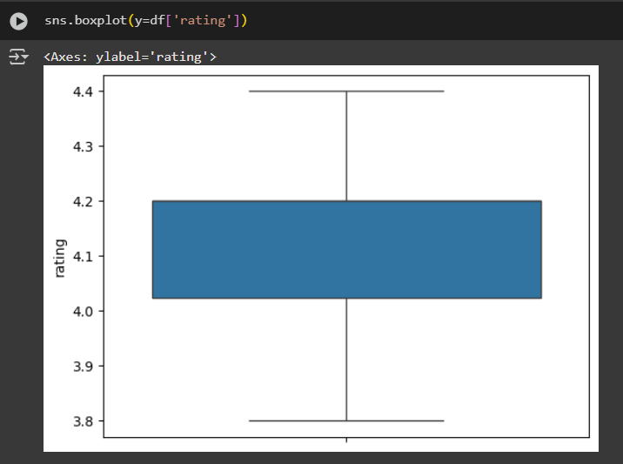
REMOVING OUTLIERS
To address these outlier, we will apply IQR method:

Slide 28
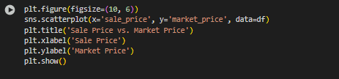
STEP 9: CREATE PLOTS AND VISUALISATIONS.
Relationship between sale_price and market_price.
Insights:
The majority of points fall below the diagonal (y = x), indicating that the sale price is often lower than the market price.
There is a clear positive correlation: as the sales price increases, the market price tends to increase too.
There are several horizontal clusters (especially at market prices around 300 and 400), indicating products repeatedly listed with those market prices regardless of the sale price.

Slide 29
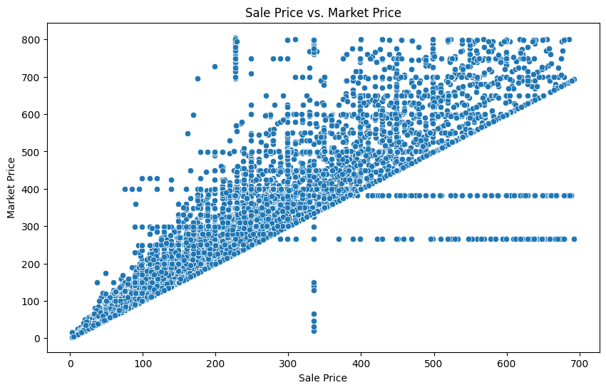
STEP 9: CREATE PLOTS AND VISUALISATIONS.
Insights:
A few vertical clusters (e.g., at sale price ≈ 300) suggest items sold at the same price but with varying market prices — potentially due to bundling, promotions, or pricing errors.
A few points are on or slightly above the diagonal — items sold at or above market value, which may be rare, premium, or in high demand.

Slide 30
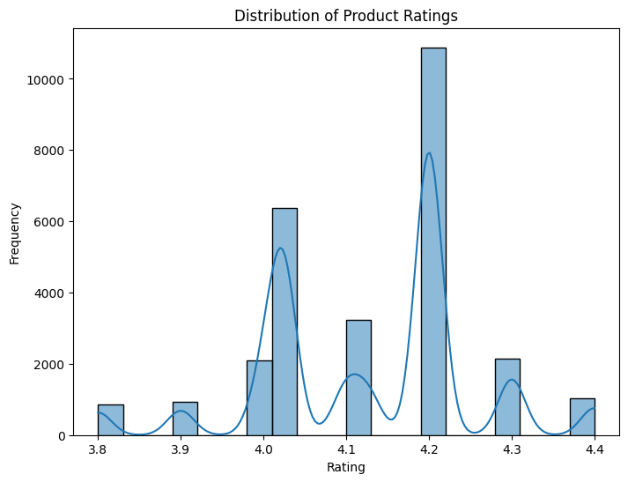
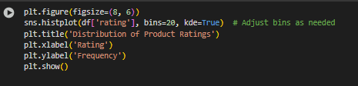
STEP 9: CREATE PLOTS AND VISUALISATIONS.
2. Distribution of Ratings.
Insights:
The distribution of product ratings is highly concentrated around 4.0 and 4.2, indicating most products receive consistently high ratings, with noticeable frequency peaks at these values.

Slide 31

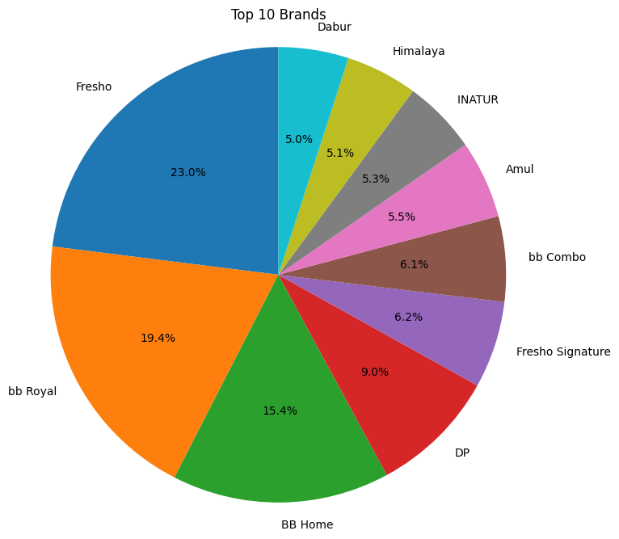
STEP 9: CREATE PLOTS AND VISUALISATIONS.
3. Market Share of Top 10 Brands.
Fresho dominates : Fresho , Big Basket's private label, has the largest market share at 23%. This indicates its popularity and success among customers.
bb Royal and BB Home are strong performers : These two brands, also likely Big Basket's own, hold significant market shares at 19.4% and 15.4% respectively. This further demonstrates the success of Big Basket's private label strategy.
Established brands have a presence : Well-known brands like Dabur, Himalaya, and Amul also feature in the top 10, although with smaller shares compared to Big Basket's own brands.
Diverse product offerings : The chart includes brands from various categories, such as personal care (Dabur, Himalaya), dairy (Amul), and packaged foods (Fresho Signature, bb Combo). This suggests Big Basket offers a wide range of products to cater to different customer needs.

Slide 32
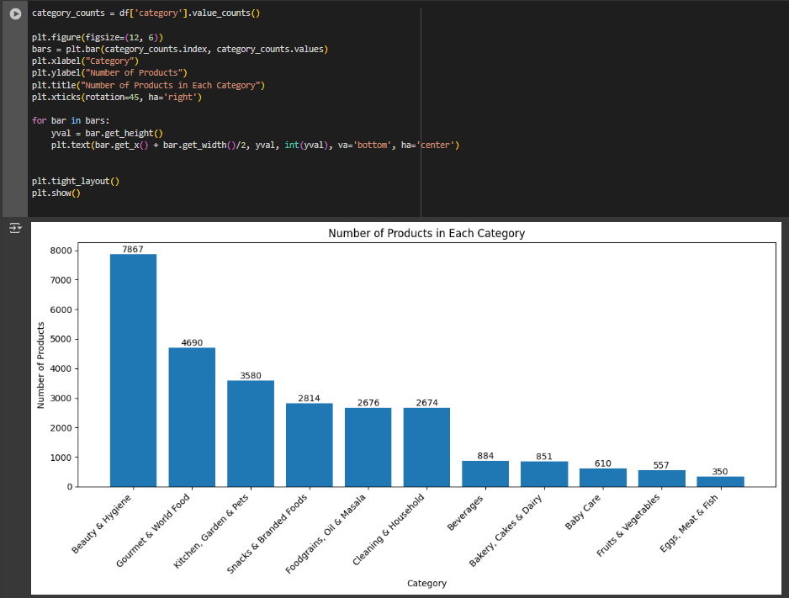
STEP 9: CREATE PLOTS AND VISUALISATIONS.
4. Number of products in each category.

Slide 33
STEP 9: CREATE PLOTS AND VISUALISATIONS.
Key Insights:
The most popular category is “Beauty & Hygiene” , “Gourment & World Food” , “Kitchen, Garden & Pets” .
The least popular categories are “Egg , Meat and Fish" and “Fruits and Vegetables".
The distribution of products across categories is not even, with some categories having significantly more products than others.

Slide 34
KEY SUMMARY
Brand Performance Insights
Fresho, Big Basket’s private label, holds the largest market share at 23%, showing strong popularity and customer loyalty.
Other Big Basket private brands, bb Royal (19.4%) and BB Home (15.4%), also perform well, reflecting the success of the company’s private label strategy.
Popular national brands like Dabur, Himalaya, and Amul appear in the top 10, though with smaller shares, highlighting a competitive but private-label-dominated market.
The product range spans across personal care, dairy, packaged foods, and household goods — indicating Big Basket’s broad inventory to meet varied customer needs.

Slide 35
KEY SUMMARY
Category Popularity Insights
Top-selling categories include Beauty & Hygiene, Gourmet & World Food, and Kitchen, Garden & Pets, reflecting customer interest in personal care, premium foods, and home essentials.
Egg, Meat & Fish and Fruits & Vegetables rank low in product count, suggesting either lower demand or a more curated selection.
Some categories carry a significantly larger number of products, indicating focused growth or stocking strategies in high-demand segments.

Slide 36
THANK YOU!

